Slide 2

SLEAP: DL Models for Markerless Motion Tracking
António Medeiros 109227
Pedro Vasques​ 103665

Slide 3
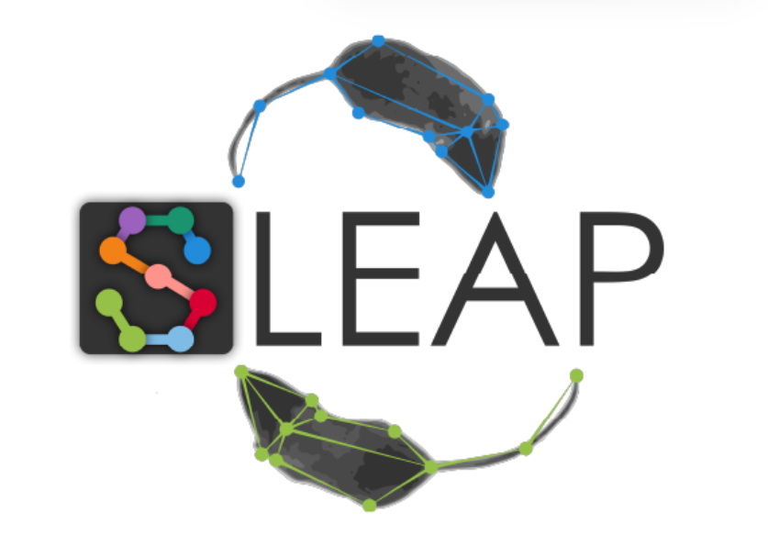
Introduction
Main Objectives
To integrate and evaluate SLEAP models
To systematically modify and evaluate hyperparameters to optimize performance for different video datasets
To analyse and interpret the technical background of each neural network model
3

Slide 4
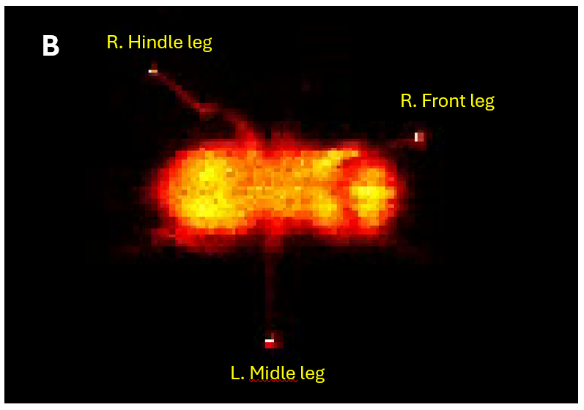
SLEAP
Purpose of SLEAP
Deep learning framework for markerless motion tracking in animals.
Enables precise behavioral analysis from video data.
Capabilities
Detects and tracks anatomical landmarks across multiple species (flies, mice, fish).
Supports multi-animal tracking, even during interactions or overlaps.
Customization Options
Users can tune architecture parameters and hyperparameters.
Trade-off between speed and precision depending on experimental needs.
Post-Training Capabilities
Fast inference for long video analysis.
Tracks poses and identities over time with high efficiency.

Slide 5
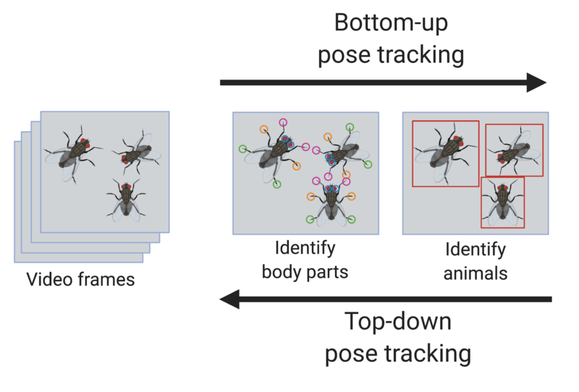
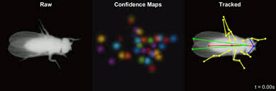
Training Strategies
Single Animal

Slide 6
Neural Network Architectures
ResNet:
High accuracy, ideal for complex poses and dense scenes.
MobileNet:
Optimized for low-power devices and batch processing.
U-Net:
Lightweight and fast, suitable for real-time or resource-limited setups.

Slide 7





Dataset and Training Strategy
SLEAP GUI
Img_to_vid.py
"Skeleton" Definition
Manual Labeling Frame by Frame
7 Videos
1143 Frames in total
9 points
453 labeled frames
90/10 split
Fly1.2.mp4 -> Test Set
Seed: 42
Training_and_inference_using_Google_Drive.ipynb

Slide 8
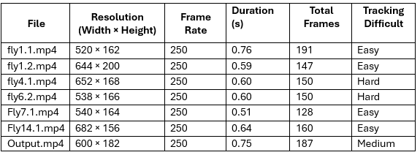
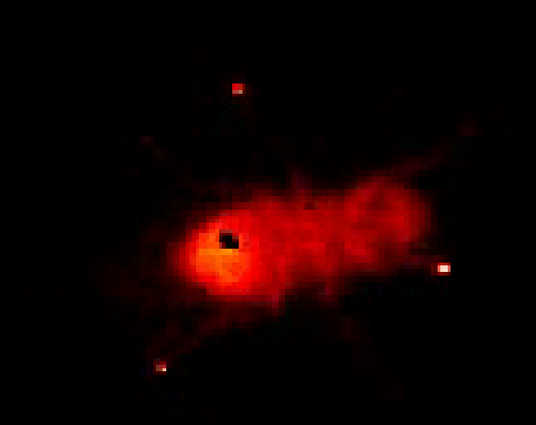
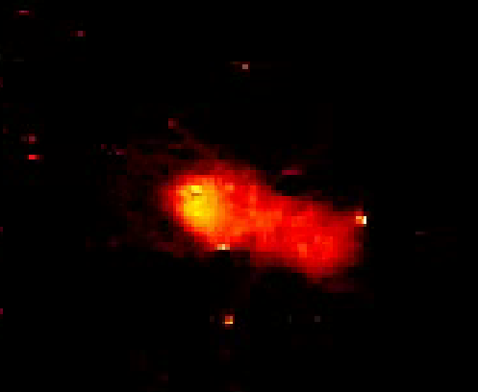
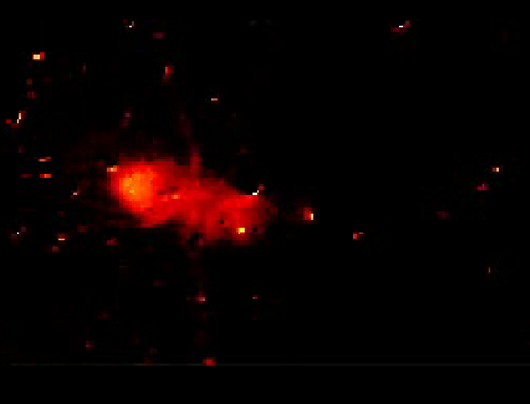
Videos Dataset
EASY
MEDIUM
HARD

Slide 9
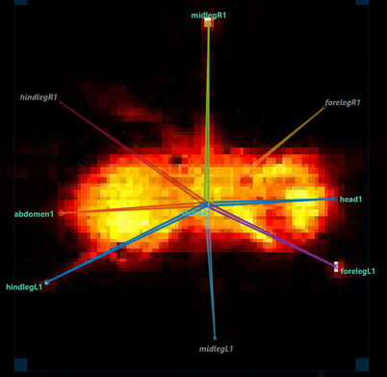
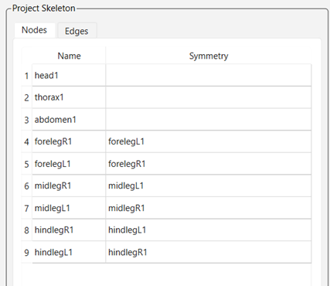
"Skeleton"

Slide 10
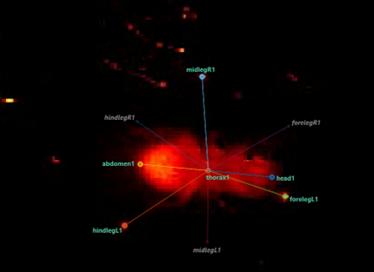
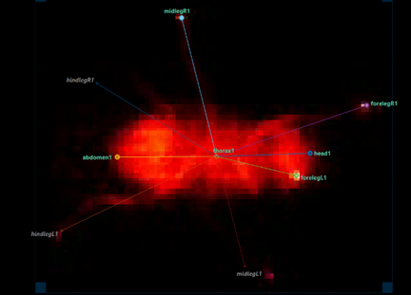
Manual Labeling
453 manually labeled frames (Previous studies using DL show performance stabilization after labeling around 300-500 frames)
The selected frames represent a variety of fly postures, lighting conditions, and challenging labeling situations.
SPLIT 90/10 (407/46 frames)
Seed: 42
Test Set : full video fly1.2.mp4 (to assess real world performance)

Slide 11
Dataset and Training Strategy
SLEAP GUI
Img_to_vid.py
"Skeleton" Definition
Manual Labeling Frame by Frame
7 Videos
1143 Frames in total
9 points
453 labeled frames
90/10 split
Fly1.2.mp4 -> Test Set
Seed: 42
Training_and_inference_using_Google_Drive.ipynb

Slide 12
UNet - Neural Network Architecture
Network Structure:
Encoder: progressively reduces spatial resolution while increasing feature depth.
Decoder: restores resolution via up-sampling, refining keypoint localization.
Data augmentation during training:
Rotation, flipping, scaling, contrast adjustment.
Training Setup
Loss function: Mean Squared Error (MSE) on confidence maps.
Optimizer: Adaptive Moment Estimation (Adam).
Training guided by minimizing loss over batches of augmented images.
Parameter Tuning
Parameters based on prior studies and SLEAP defaults.
Includes filter size, stride, kernel size, number of blocks, and interpolation method.

Slide 13
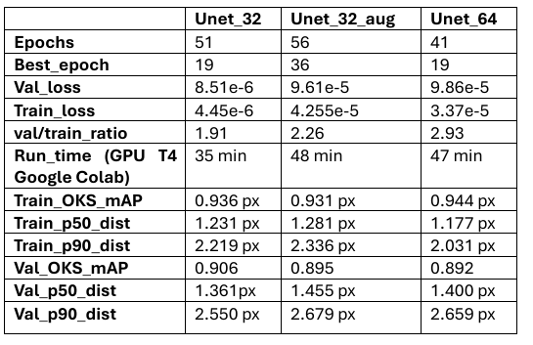
Results and Models Comparison
Train_loss: The error (loss function value) on the training set
Val_loss: The error on the validation set
Val_OKS_mAP: Validation Object Keypoint Similarity Mean Average Precision (closer to 1 the better)
Val_p50_dist: Mean pixel distance on validation data.

Slide 14
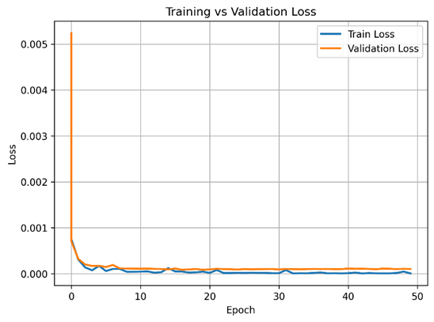
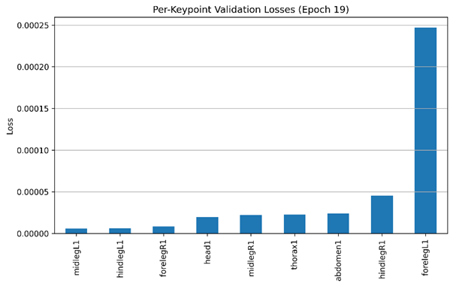
Best Model Performance (Unet_32)

Slide 15
Fly 1.2.mp4 Predictions Best Model

Slide 16
Conclusion & Future Improvements
Performance: 90,6% and a validation p50_dist of 1.36 pixels
the validation-to-training loss ratio and the slight performance gap between training and validation metrics suggest the onset of overfitting.
In some cases, the model also predicts legs that are not visible in the frame (Figure 7). This behavior suggests that the confidence map threshold used for keypoint detection may be too permissive.
Metrics to include: false-positive and false-negative keypoint detection
Despite its overall good performance, the model still requires further tuning, as even a 10% error rate results in a significant amount of manual correction
Don’t train models without GPU

Slide 17
103665 – Want to Continue the Project

